Slide 1
Thimbles Project

Slide 2

ICON

Slide 3

MAIN MENU

Slide 4
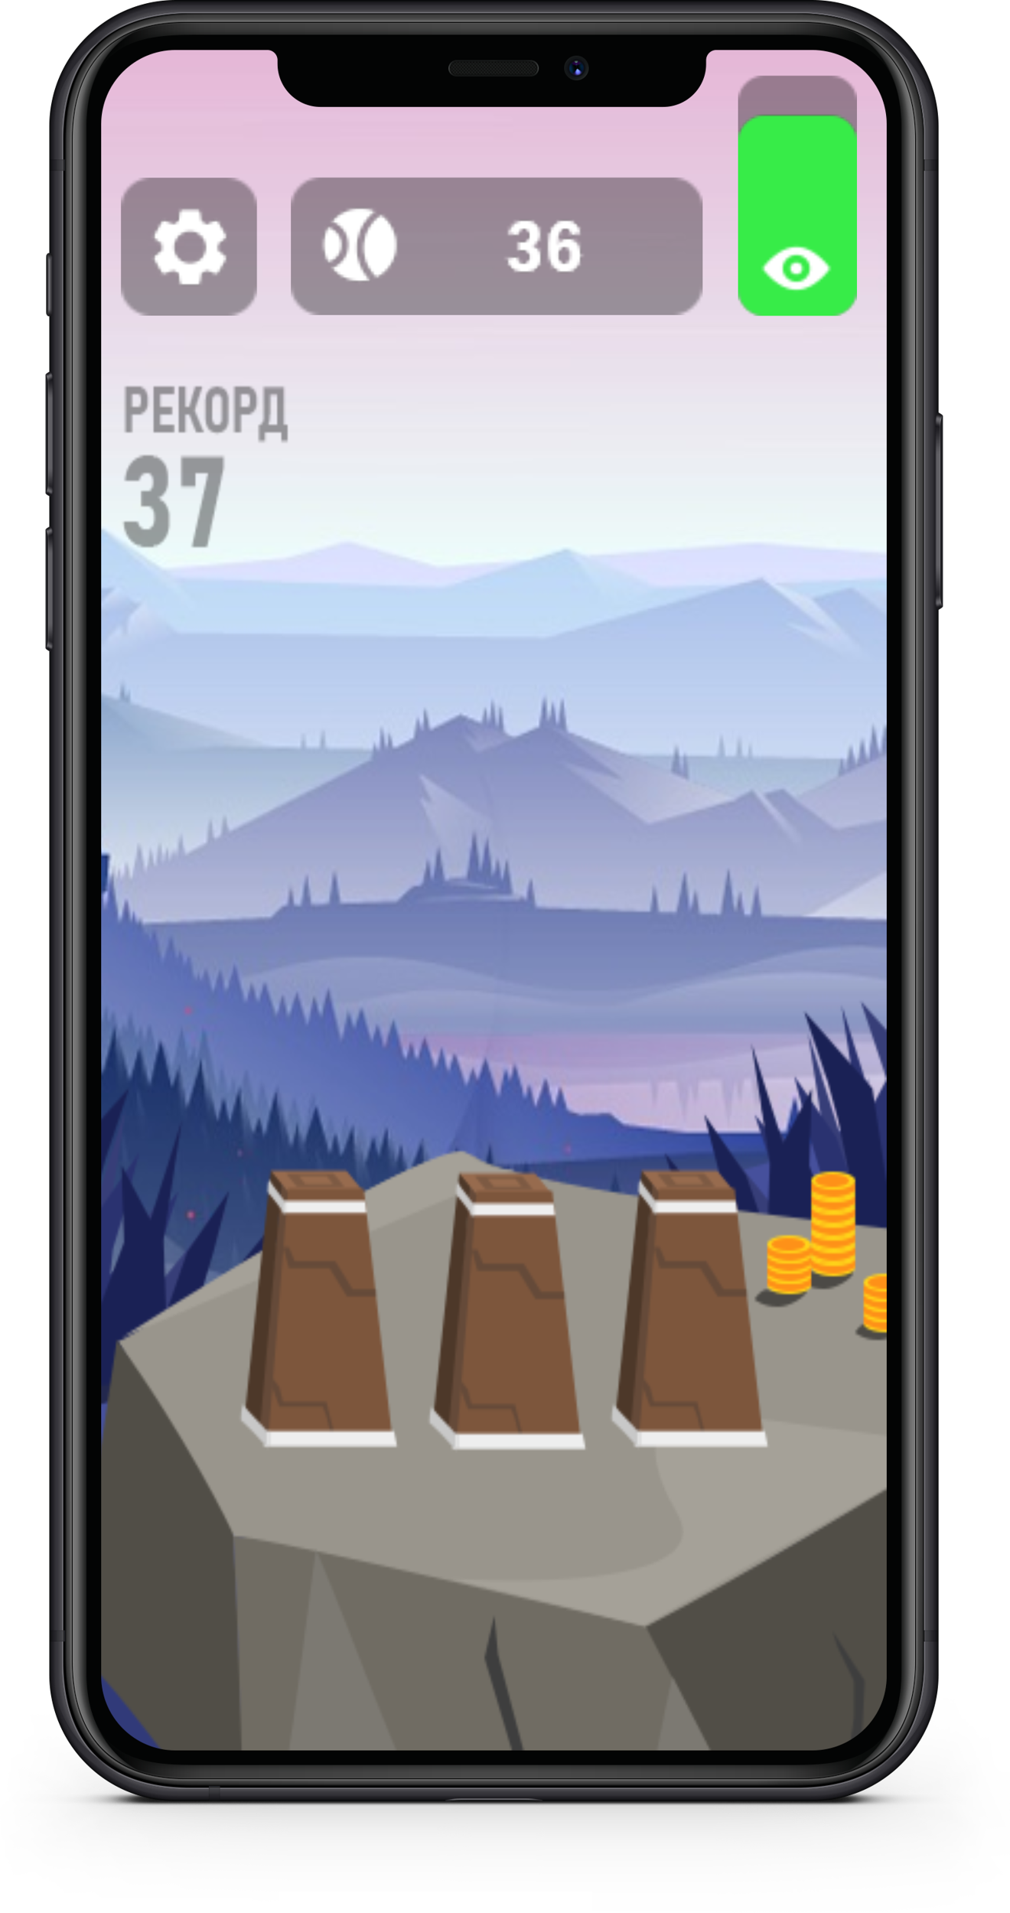
GAME AREA

Slide 5
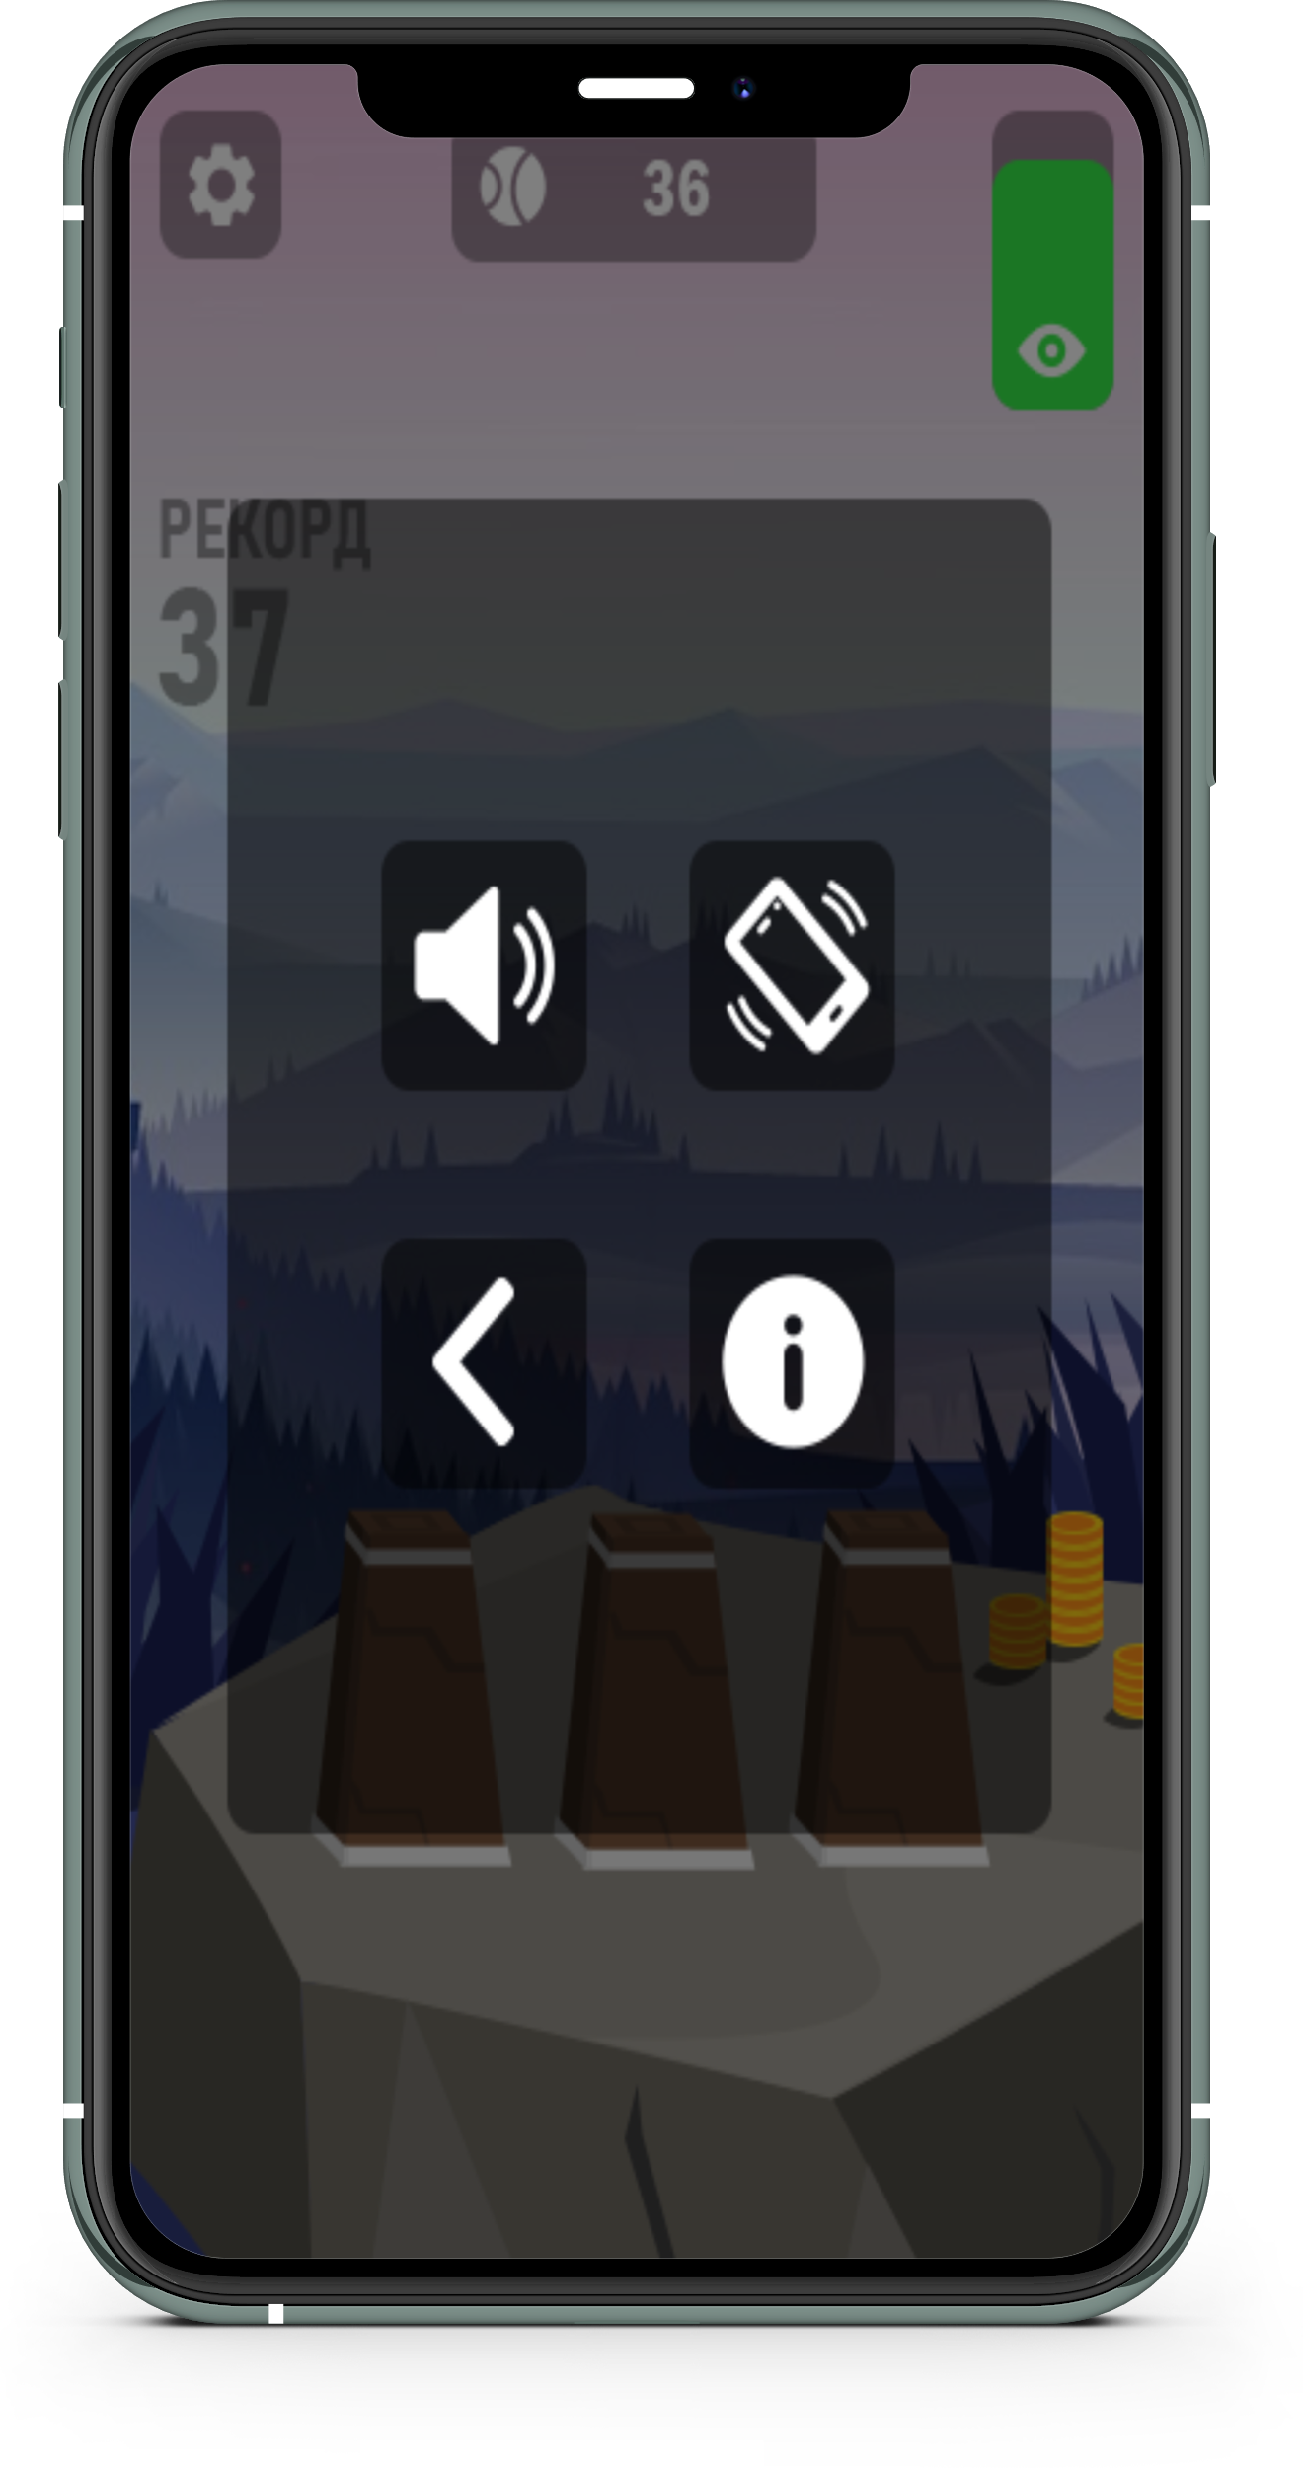


SETTINGS

Slide 6
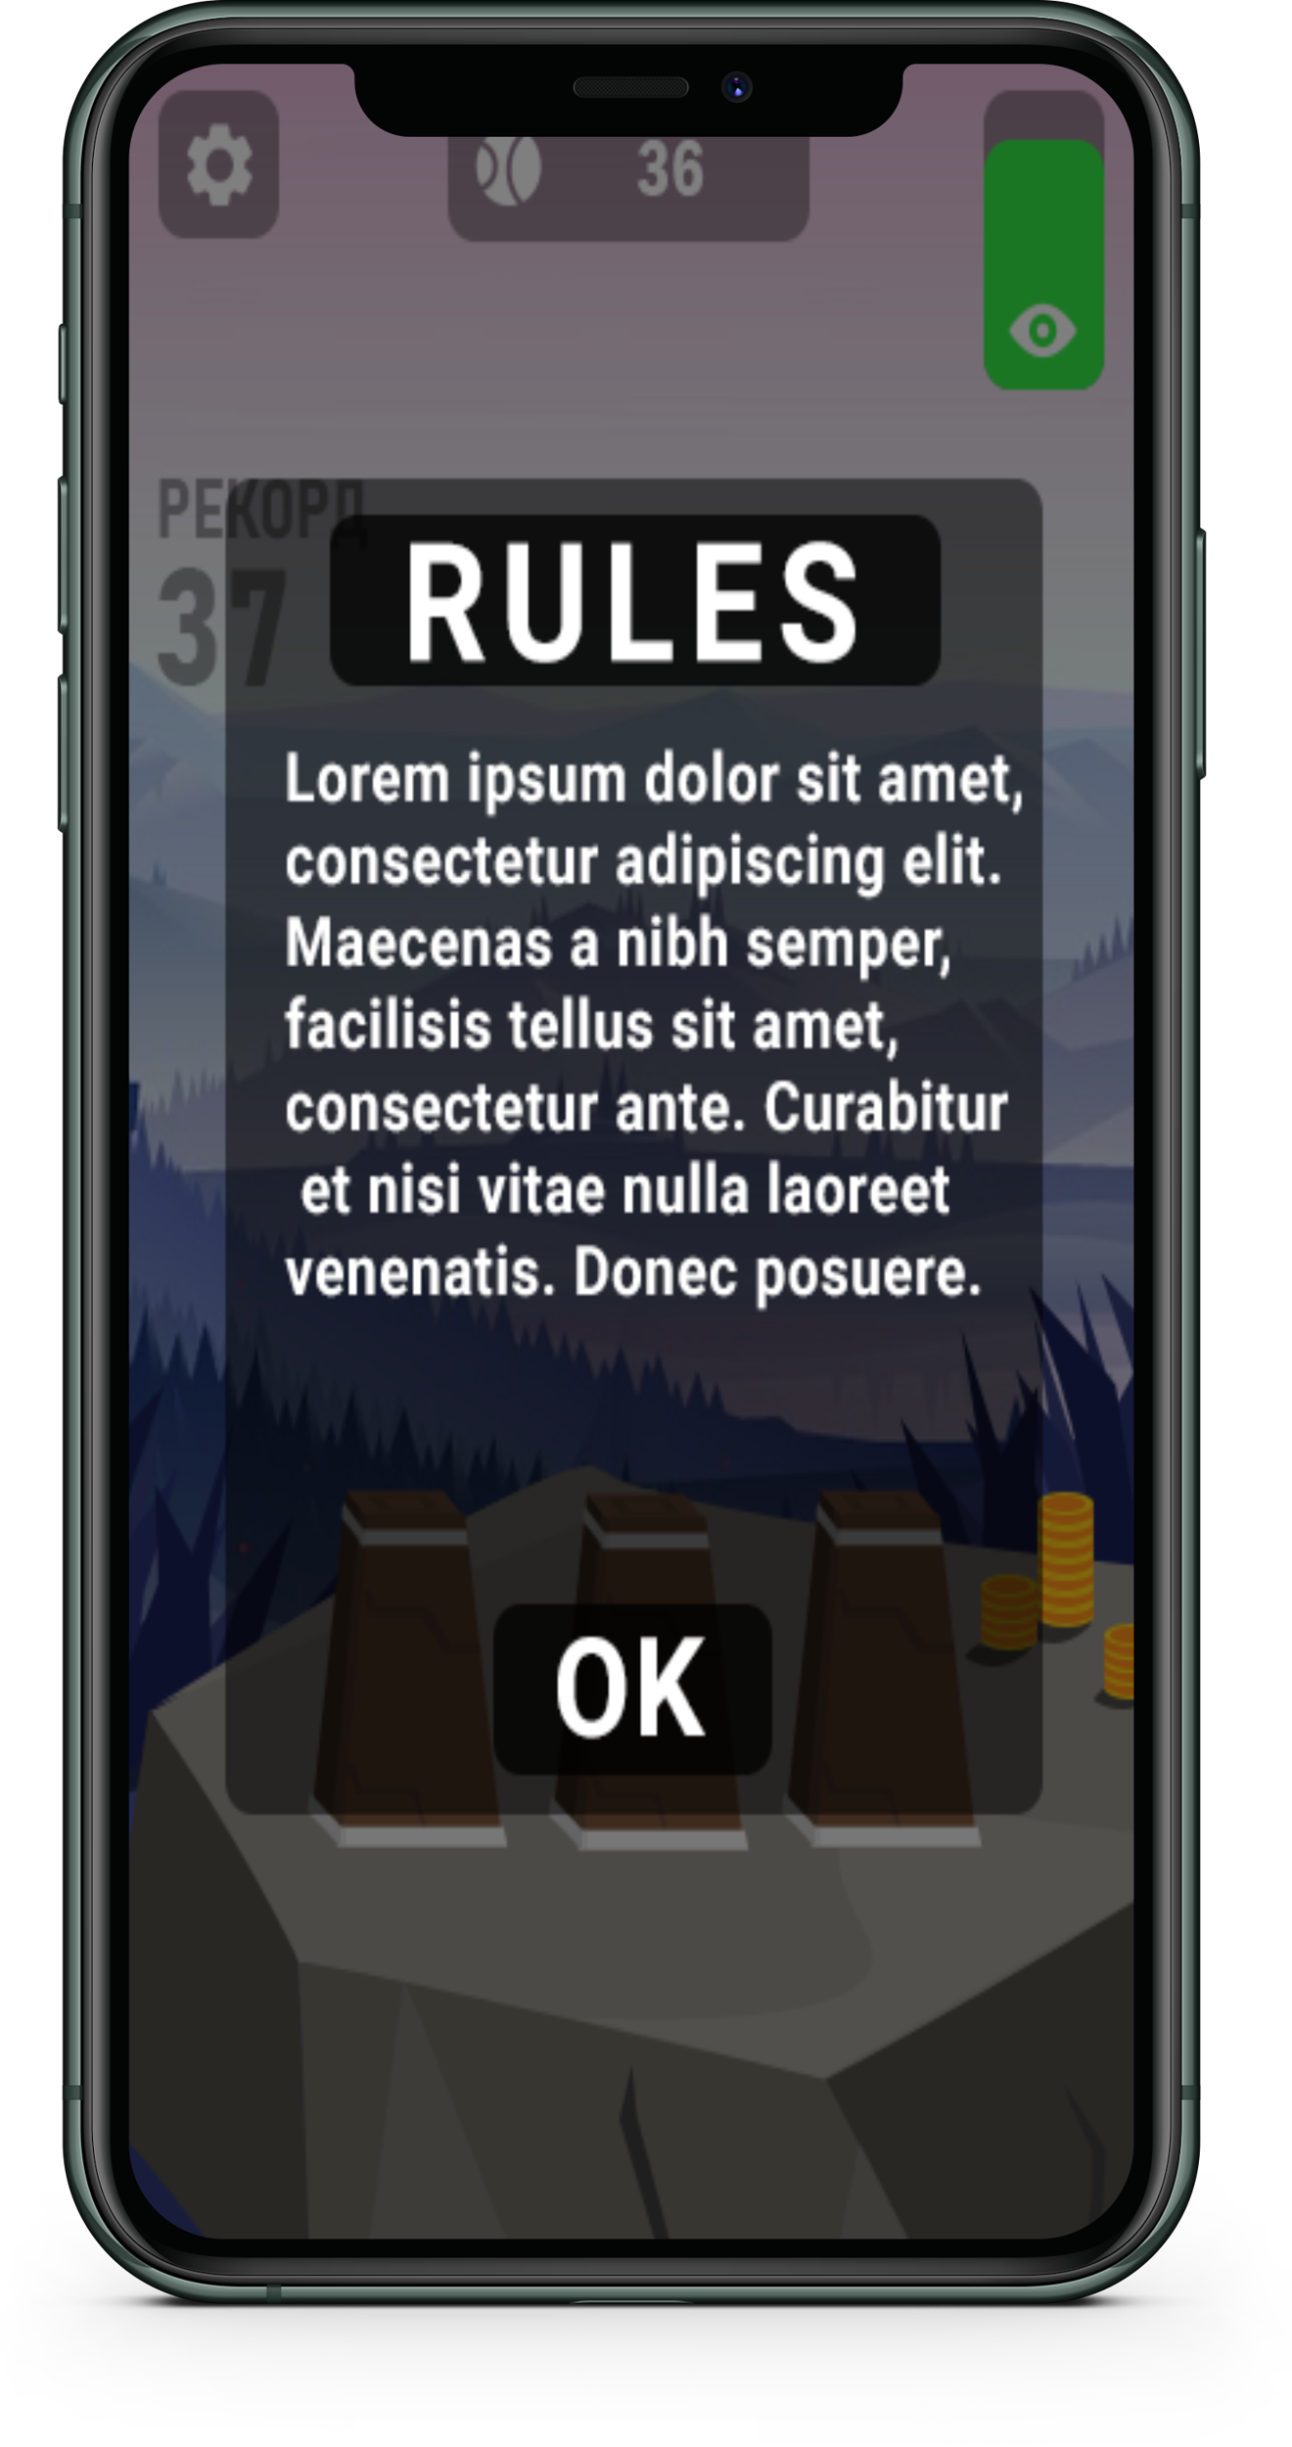
RULES

Slide 7
РЭХМЭТ ЗА ATTENTION

